Slide 1

Machine Learning
Reliability test and improvement of a sensor system for object detection
Submitted By: Deblina Karmakar (1427365)
INDRANIL saha (1427190)
Examined By: Prof. Dr. ANDREAS PECH

Slide 2
INDEX
Introduction
Methodology
Implementation
Results
Conclusion

Slide 3

Introduction
The project generates an acoustic signal to detect its echoes, enhancing echo detection reliability of the sensor system..
It delves into sophisticated methodologies for enhancing the reliability of echo detection.
It assesses how signal processing errors affect measurement precision.
It develops comprehensive models using various algorithms to detail ultrasonic signal behaviors across distances and interactions with objects.

Slide 4
Methodology
Red Pitaya Measurement Board
Red Pitaya STEM Lab is based on a system-on-a-chip (SoC) from the former company Xilinx.
SoC integrates FPGA technology, offering customizable and powerful processing capabilities for various computational tasks.
Equipped with 2 analog RF inputs and outputs, supports a wide frequency range, alongside numerous digital I/O ports for versatile interfacing.
Provides Ethernet and Wi-Fi options for remote operation and data analysis, including USB connections for direct interfacing and programming.
Operates on an open-source Linux operating system.
Ultrasonic sensor and red pitaya device

Slide 5
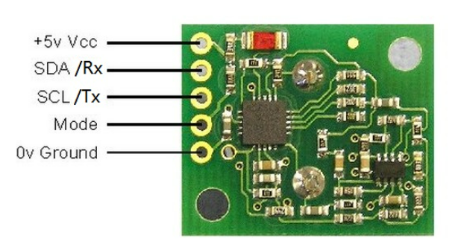
Methodology
Ultrasonic Sensor
The Ultrasonic Sensor SRF02 is a single transducer ultrasonic rangefinder in a tiny footprint PCB.
Features a single transducer design, resulting in a minimum detection range of 15 cm due to its dual role in emission and reception.
The system is adept at handling RF signals within a 50MHz frequency range, ensuring efficient transmission and reception.
Red Pitaya's primary unit includes 16 digital I/O ports, 2 analog RF I/O ports, a micro-SD card slot, an RJ45 Ethernet socket, a USB port.
Equipped with a 5V power supply.
Pin function of the SRF02 Ultrasonic sensor

Slide 6
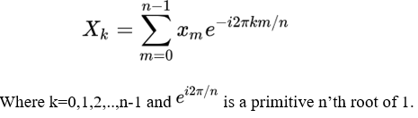
Methodology
Fast Fourier Transform
The FFT is a computational tool for signal analysis on digital computers.
FFT efficiently calculates the discrete Fourier transform of data samples or time series.
Most prevalent FFT algorithm is the Cooley-Tukey algorithm.
A divide-and-conquer algorithm, recursively breaking down a DFT of any composite size n=n1*n2, into smaller DFTs of sizes n1 and n2.
It includes O(n) multiplications by complex roots of unity, known as twiddle factors.
DFT equation:-

Slide 7
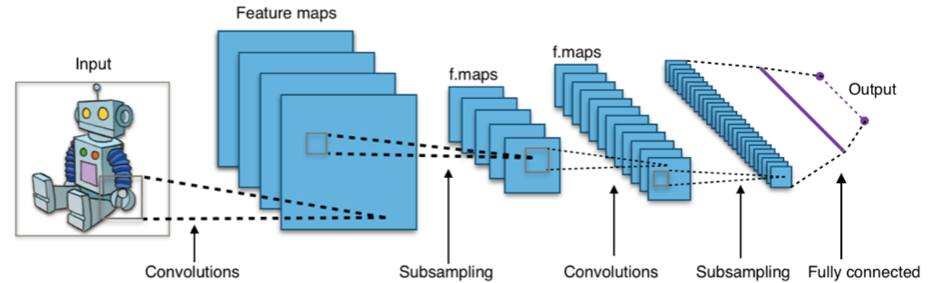
Methodology
Convolutional Neural Network (CNN)
CNNs consist of multiple layers with nodes that calculate activation maps to pinpoint crucial features within data, like images.
Use a convolution process with filters to highlight significant visual elements, such as patterns and edges.
The network's learning involves tuning node weights to match the training data's labels, ensuring the model generalizes effectively and prevents overfitting when encountering new data.

Slide 8
Methodology
Random Forest
In the Random Forest model, a subset of data points and a subset of features is selected for constructing each decision tree. Simply put, n random records and m features are taken from the data set having k number of records.
Individual decision trees are constructed for each sample.
Each decision tree will generate an output.
Final output is considered based on Majority Voting or averaging for Classification and regression, respectively.

Slide 9
Methodology
XGBoost
XGBoost is a gradient boosting algorithm in the ensemble learning category.
It uses decision trees as base learners and includes regularization to improve generalization.
Known for efficiency, feature importance evaluation, and handling of missing data.
Applicable to regression, classification, and ranking problems.
Unlike bagging (e.g., Random Forest), boosting employs shallow trees, leading to interpretability.
Model parameters, such as tree count, learning rate, and tree depth, are tuned using validation methods like k-fold cross-validation.

Slide 10
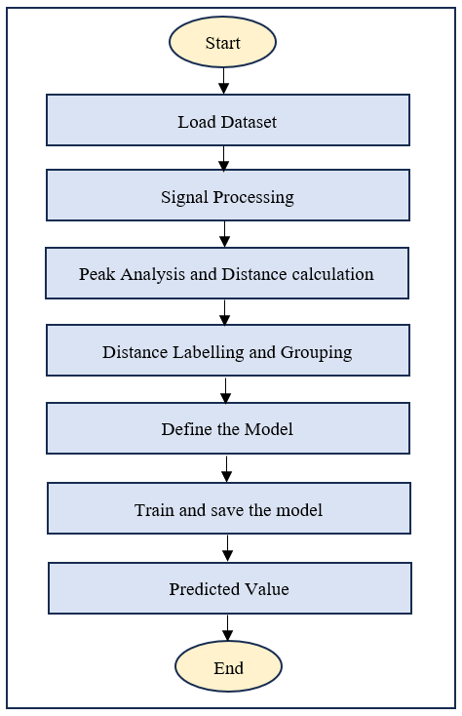
Implementation
Workflow Diagram

Slide 11


Implementation
Measurement Setup and Data Collection

Slide 12
Implementation
Implementation of CNN
Initialization Phase: Training parameters are established, encompassing the verbosity level, the total number of training epochs, and the specified batch size.
Model Definition: Model is structured sequentially with Conv1D layers for processing, employing dropout and max pooling for normalization and size reduction, and dense layers with softmax for output probabilities.
Model Compilation: Compilation uses categorical cross entropy loss function and the Adam optimizer.
Training: Training proceeds on (x_train, y_train) following the defined epochs and batch size.
Evaluation: Model's performance and accuracy are rigorously evaluated against the test dataset.
Model Saving: Fully trained model is preserved on the file system, facilitating future access and utilization.

Slide 13
Implementation
Implementation of Random Forest
Parameter Grid Construction: Grid is constructed with criteria including the count of trees (n_estimators), maximum features for node splitting (max_features), tree depth (max_depth), and minimum samples for a split (min_samples_split) etc.
Randomized Hyperparameter Search: RandomizedSearchCV deviates from exhaustive parameter searches by selecting random samples from the parameter space, optimizing the trade-off between thoroughness and efficiency.
Model Training with Best Parameters: Model undergoes training with the most effective hyperparameters to enhance learning and generalization.
Model Preservation: Refined model is preserved onto the file system, typically in a pickle file format.
Prediction and Performance Evaluation: The model’s predictive power and performance are evaluated by making predictions on both the training and test datasets.
Return of the Trained Model: The fully trained model is now poised for deployment, ready to make high-quality predictions.

Slide 14
Implementation
Implementation of XGBoost
Model Initialization: Sets key parameters, with the objective function typically being binary:logistic, aligning the model to predict binary outcomes.
Model Training: Involves the iterative construction of trees, each refining the model's precision by addressing the previous trees' errors.
Model Saving: The model is serialized, enabling storage and later access without retraining, simplifying deployment and further analysis.
Evaluation: The model is assessed on training and test data, utilizing the F1 score as the key metric for the predictive accuracy of each prediction.
Return of the Trained Model: Fully trained equipped with the learned parameters, stands as a powerful tool for making predictions on new data.

Slide 15
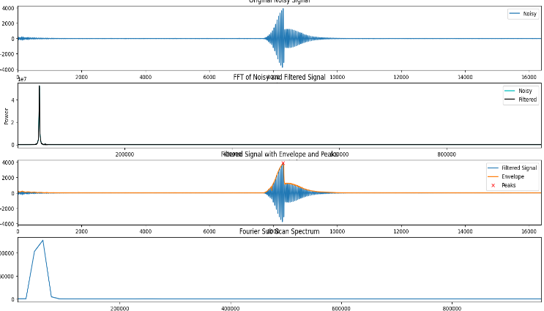
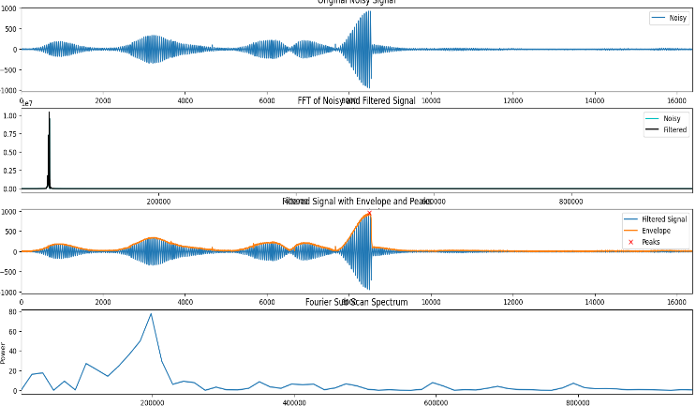
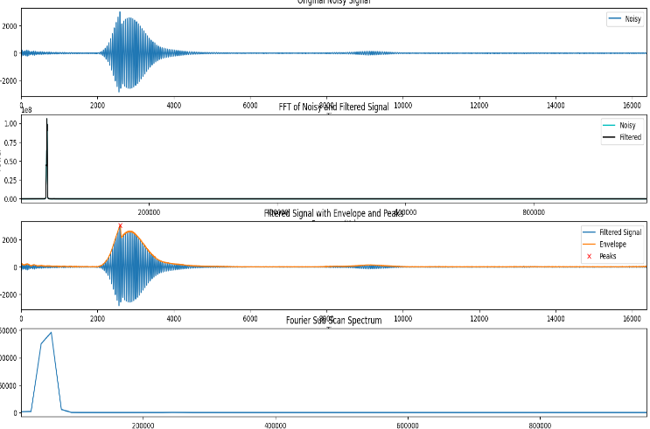
Results
ADC to FFT plot for hard object placed at 1m
ADC to FFT plot for person sitting at 1m
ADC to FFT plot for hard object placed at 50cm
ADC to FFT plot for person placed at 50cm

Slide 16
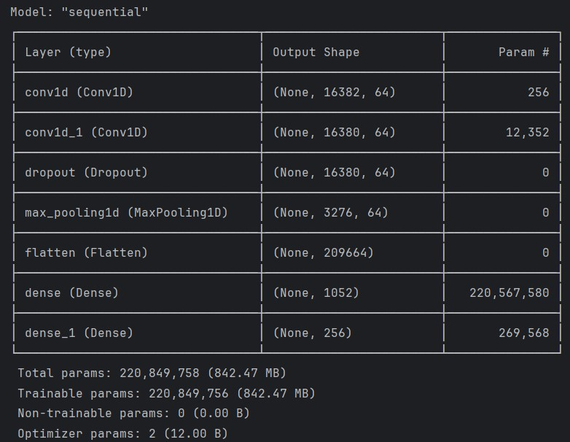
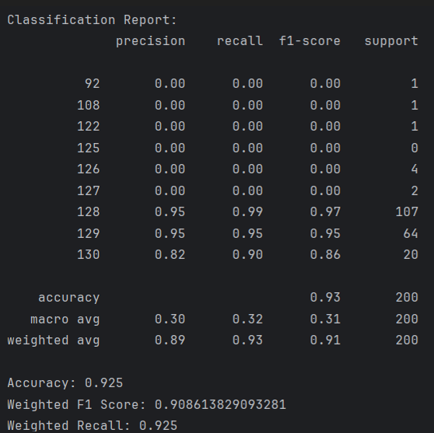
Results
CNN Model Summary
Classification report of the CNN model

Slide 17
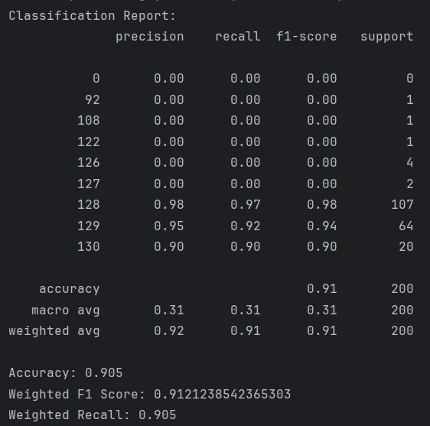
Results
F1 scores for Training and Test Data of Random Forest
Classification report of Random Forest Model

Slide 18
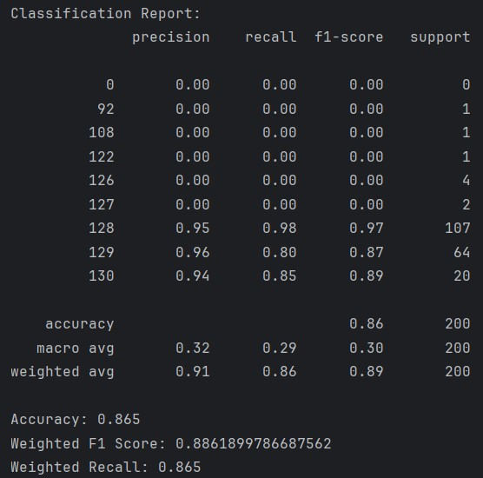

Results
F1 scores for Training and Test Data of XGBoost
Classification report of XGBoost Model

Slide 19
Conclusion
The project provides valuable understanding of an ultrasonic sensor's data collection capabilities across various distances and orientations.
It emphasizes the importance of the sensor for capturing raw data that is subsequently converted into FFT by specialized software.
A suite of ML models has been created to analyze sensor data, each demonstrating varying levels of accuracy and F1 scores.
The CNN model emerged as the standout selection.
The Random Forest model demonstrated impressive accuracy, highlighting the strength and adaptability of ensemble approaches for such data analysis tasks.
Although the XGBoost model was slightly behind in terms of performance, it still achieved respectable accuracy, proving its worth as an efficient and scalable option.

Slide 20


